Slide 1

Black Holes in
General Relativity and Astrophysics
Theoretical Physics Colloquium on Cosmology 2008/2009
Michiel Bouwhuis

Slide 2
Content
Part 1: Introduction to Black Holes
Part 2: Stellar Collapse and Black Hole Formation
Black Holes in General Relativity and Astrophysics

Slide 3
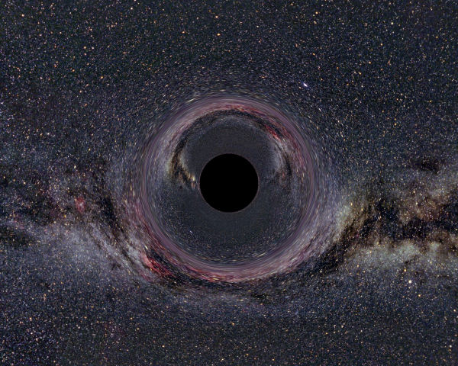
Black Holes in General Relativity and Astrophysics
Part 1:
Introduction to Black Holes
Black Holes in General Relativity and Astrophysics

Slide 4
Introduction to Black Holes
Outline
The Schwarzschild Solution for a stationary,
non-rotating black hole
Properties of Schwarzschild black holes
Adding rotation: The Kerr metric
Properties of Kerr black holes
Adding charge: The Kerr-Newman metric
Black Holes in General Relativity and Astrophysics

Slide 5
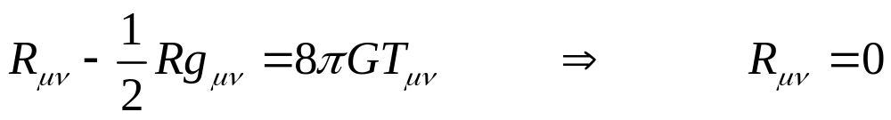
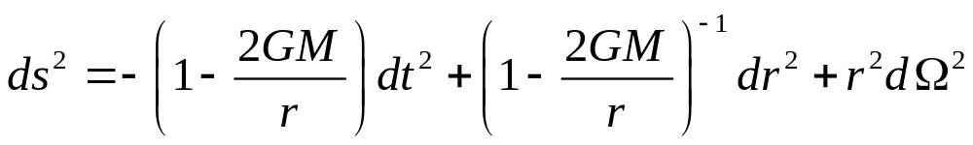
The Schwarzschild Metric
Vacuum Einstein Field Equations
Spherically symmetric solution
Describes space outside any static, spherically symmetric mass distribution
Black Holes in General Relativity and Astrophysics

Slide 6
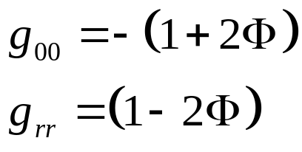
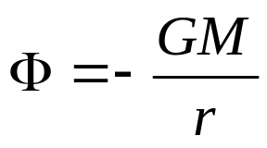
The Schwarzschild Metric
The parameter M can be identified with mass, as can be seen by taking the weak field limit:
By Birkhoff’s Theorem, the Schwarzschild solution is the unique solution
Taking M = 0 or r → ∞ recovers Minkowski space
Black Holes in General Relativity and Astrophysics

Slide 7
The Schwarzschild Metric
The metric becomes singular at r = 0 and r = 2GM
r = 0 : True singularity of infinite space-time curvature
r = 2GM : Singular only because of choice of coordinate system
Black Holes in General Relativity and Astrophysics

Slide 8
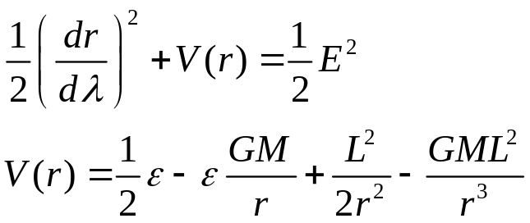


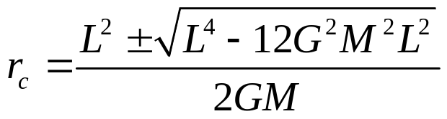
Motion of test particles
Solving the geodesic equations and using symmetry and conservation laws we get:
This gives circular orbits at radius r_{c} if
For massless particles (ε = 0) this gives
For massive particles (ε = 1) we have
Black Holes in General Relativity and Astrophysics

Slide 9
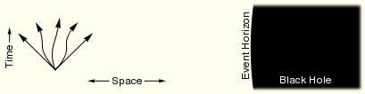
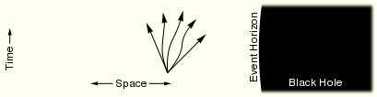

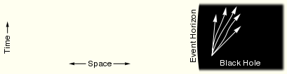
Event Horizon
If r < 2GM then dt² and dr² change sign!
All timelike curves will point in the direction of decreasing r
Black Holes in General Relativity and Astrophysics

Slide 10
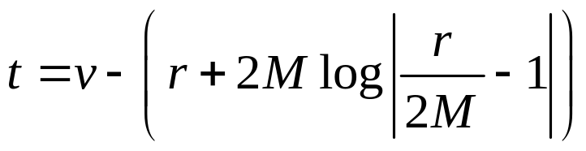
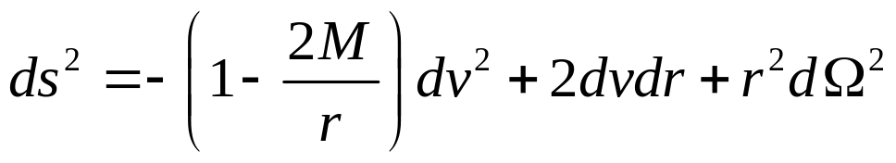
Eddington-Finkelstein Coordinates
Coordinate transform:
This gives the Eddington-Finkelstein Coordinates:
Nonsingular at r = 2M
Black Holes in General Relativity and Astrophysics

Slide 11
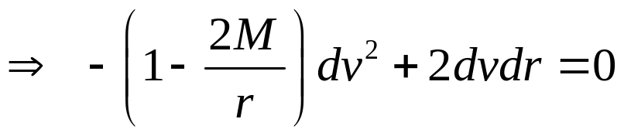

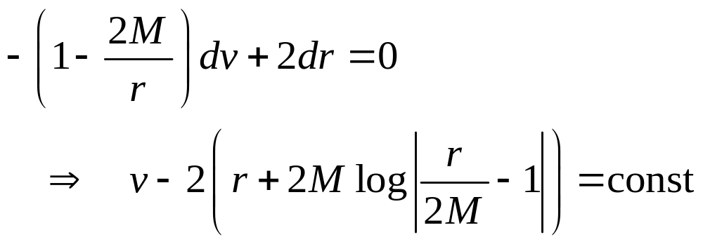
Radial Light Rays
For radial light rays we have ds² = 0 and dθ = dφ = 0
1st solution: (incomming light rays)
2nd solution:
Black Holes in General Relativity and Astrophysics

Slide 12
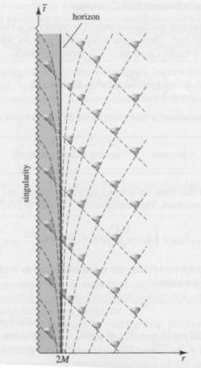
Radial Light Rays
Incomming lightrays always move inwards.
But for r < 2M ‘outgoing’ lightrays
also move inwards!
Black Holes in General Relativity and Astrophysics

Slide 13
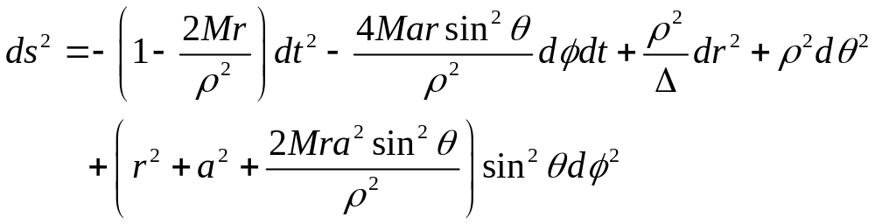
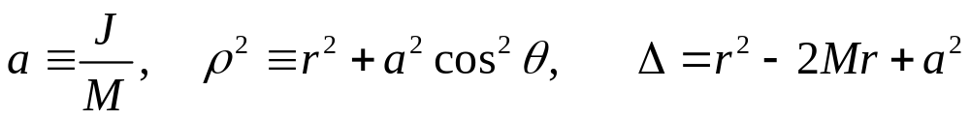
The Kerr Black Hole
Most general stationary solution to the Vacuum Einstein Field Equations
Where:
This describes space outside a stationary, rotating, spherically symmetric mass distribution
Black Holes in General Relativity and Astrophysics

Slide 14
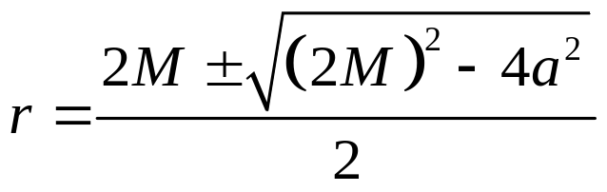
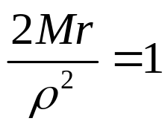
The Kerr Black Hole
Singularity at ρ = 0. This implies both r = 0 and θ = π / 2
Event Horizon at Δ = 0
Located at
The t coordinate becomes spacelike when
Black Holes in General Relativity and Astrophysics

Slide 15
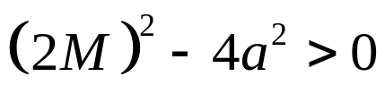

Inner and outer Event Horizon
Two solutions for
An inner and an outer event horizon!
No solutions for
No event horizon at all, but a naked singularity!
Black Holes in General Relativity and Astrophysics

Slide 16
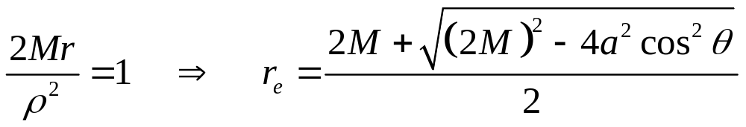
The Ergosphere
We have r_{e} > r₊. The ergosphere lies outside the event horizon
Within the ergosphere timelike curves must move in the direction of you increasing θ
Known as Lense-Thirring effect, or Frame-Dragging
Black Holes in General Relativity and Astrophysics

Slide 17
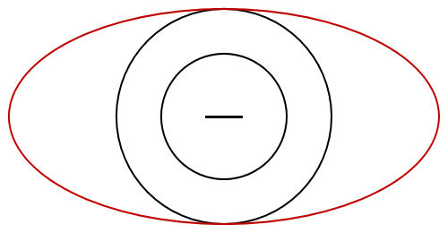
The Kerr Black Hole
Killing horizon
Outer event horizon
Singularity
Inner event horizon
Black Holes in General Relativity and Astrophysics

Slide 18
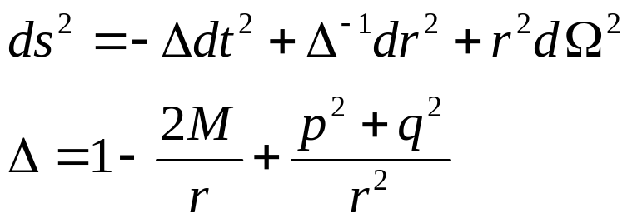
Charged Black Holes
Reissner-Nordström metric
Kerr-Newman metric
Kerr Metric with 2Mr replaced by 2Mr – (p² + q²).
No new phenomena
Black Holes in General Relativity and Astrophysics

Slide 19
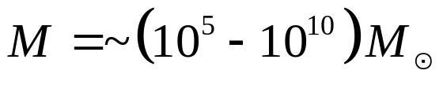

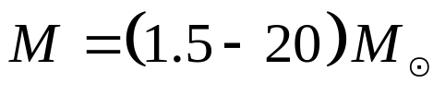

Types of Black Holes
Found in centres of most Galaxies
Responsible for Active Galactic Nuclei
Might be formed directly and indirectly
Possibly found in dense stellar clusters
Possible explanation of Ultra-luminous X-Rays
Must be formed indirectly
Remants of very heavy stars
Responsible for Gamma Ray Bursts
Formed directly
Quantum effects become relevant
Predicted by some inflationary models
Possibly created in Cosmic Rays
Will cause LHC to destroy the Earth
Supermassive BH
Intermediate-mass BH
Stellar-mass BH
Micro BH
Black Holes in General Relativity and Astrophysics

Slide 20
Black Holes in General Relativity and Astrophysics
Part 2:
Stellar Collapse and Black Hole Formation
Black Holes in General Relativity and Astrophysics

Slide 21
Stellar Collapse and Black Hole Formation
Outline
Collapse of Dust (Non-Interaction Matter)
White Dwarfs
Neutron Stars
Do Black Holes exist?
Black Holes in General Relativity and Astrophysics

Slide 22
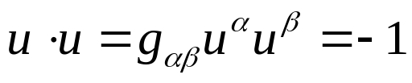
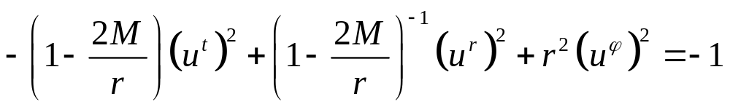
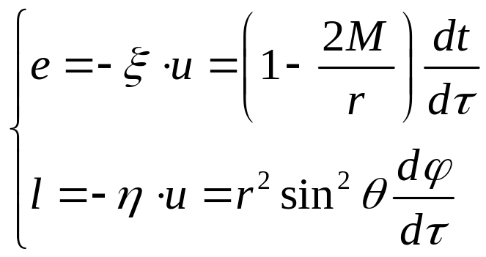
Collapse of Dust
Dust: Pressureless relativistic matter
All particles follow radial timelike geodesics
A little bit of math:
First normalize four-velocity
This gives:
From the Killing vectors we get:
Black Holes in General Relativity and Astrophysics

Slide 23
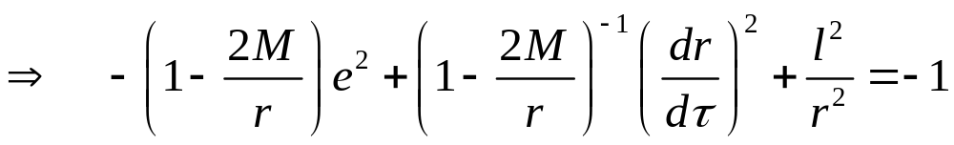
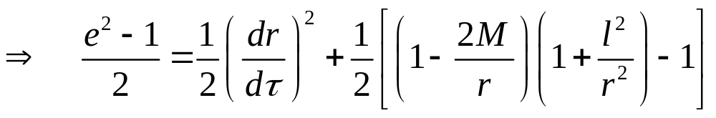
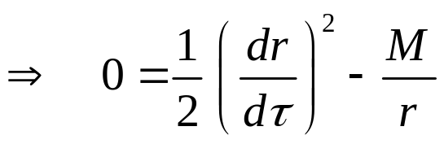
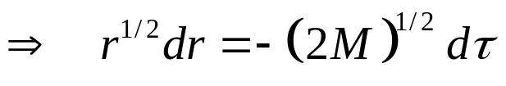
Collapse of Dust
A little bit of math:
Radial timelike geodesics initially at rest: e =1, l = 0
Black Holes in General Relativity and Astrophysics

Slide 24

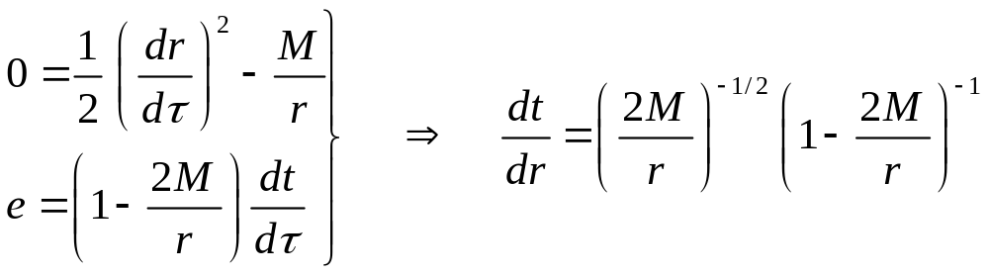
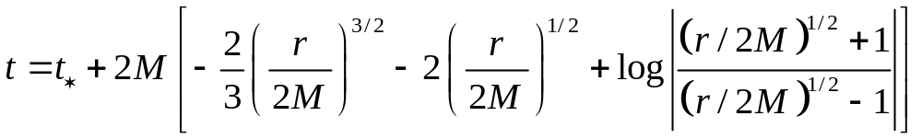
Collapse of Dust
Integration yields:
For the Schwarzschild time we find:
Here integration gives:
Black Holes in General Relativity and Astrophysics

Slide 25
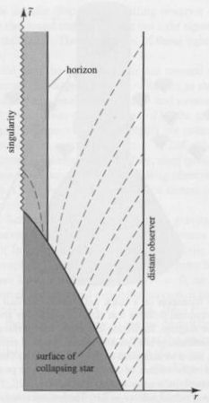
Collapse of Dust
The surface of a collapsing star reaches the event horizon at r = 2M in a finite amount of proper time, but an infinite Schwarzschild time will have passed
Signals from the surface will become infinitely redshifted.
Black Holes in General Relativity and Astrophysics

Slide 26


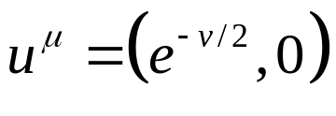
Realistic Matter
Assumptions:
Non-rotating, spherically symmetric star
Interior is a perfect fluid
Known equation of state
Static
Black Holes in General Relativity and Astrophysics

Slide 27
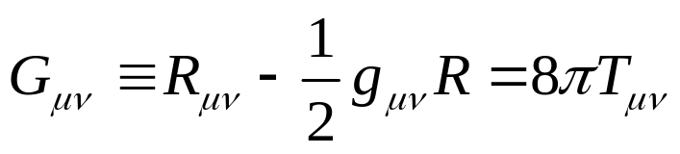
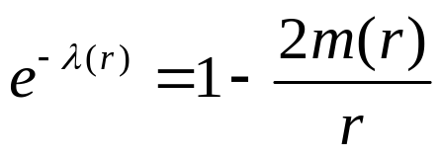
Realistic Matter
We need to solve the Einstein equations
Four unknown functions
v(r)
λ(r)
p(r)
ρ(r)
It is costumary to replace:
Black Holes in General Relativity and Astrophysics

Slide 28
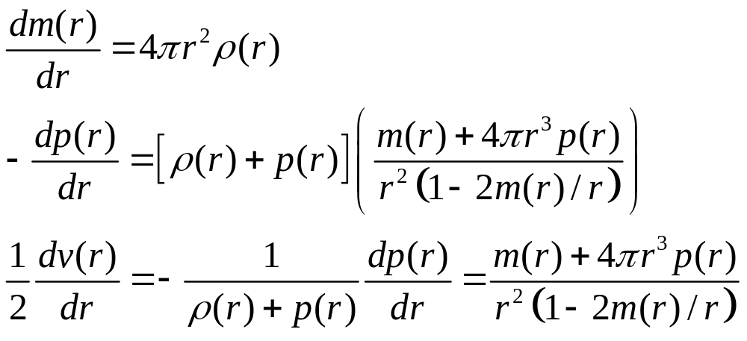
Equations of Structure
Equations describing relativistic hydrostatic equilibrium
Black Holes in General Relativity and Astrophysics

Slide 29
Gravitational Collapse
Unchecked gravity causes stars to collapse
Ordinary stars are balanced against this by the pressure due to thermonuclear reactions in the core
Once a star runs out of fuel, this process can no longer support it, and it starts to collapse
White dwarfs are balanced by the pressure of the Pauli Exclusion Principle for electrons
Neutron stars are balanced by the pressure of the Pauli Exclusion Principle for neutrons
Black Holes in General Relativity and Astrophysics

Slide 30
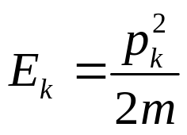
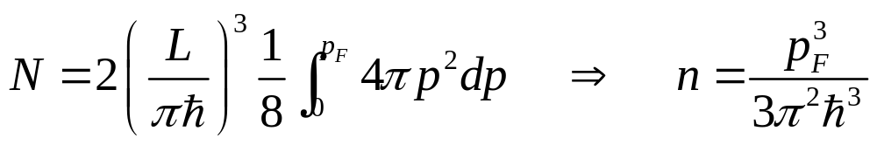
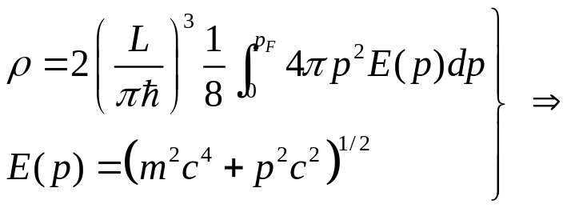
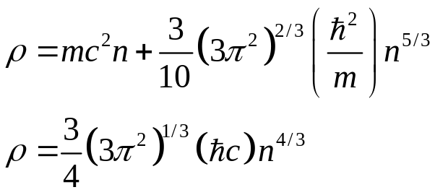
White Dwarfs (or Dwarves)
Single fermion in a box
For N fermions we have
The energy density is given by
(nonrelativistic)
(relativistic)
Black Holes in General Relativity and Astrophysics

Slide 31



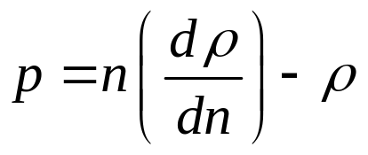
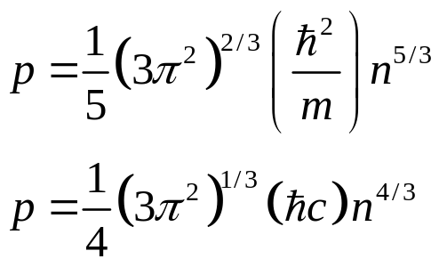
White Dwarfs
To find the pressure, use
where and
This gives
(nonrelativistic)
Giving us for the pressure
(relativistic)
We now have both density and pressure in terms of n.
Eliminate n to find equation of state p = p(ρ)
Black Holes in General Relativity and Astrophysics

Slide 32
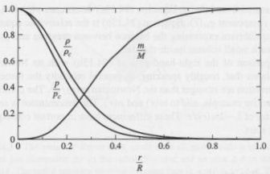
White Dwarfs
Now all that’s left to do is solving some integrals!
Easiest to do numerically: Pick a core density ρ_{c} and integrate outward.
Black Holes in General Relativity and Astrophysics

Slide 33
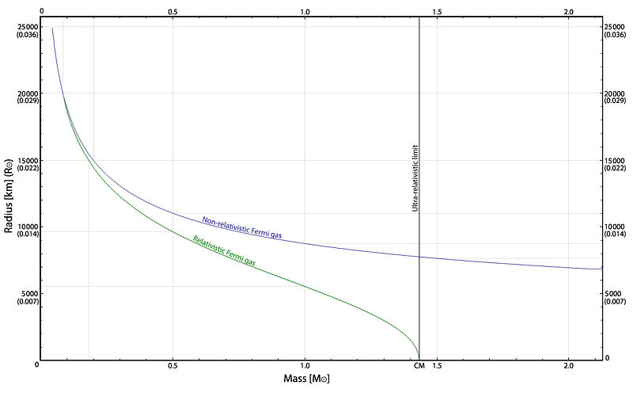

White Dwarfs
Plotting R as a function of M we find
White Dwarfs have a maximum mass!
- Chandrasekhar mass
Black Holes in General Relativity and Astrophysics

Slide 34
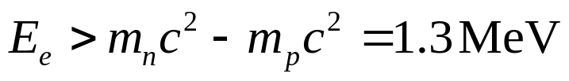
Neutron Stars
As a White Dwarf compresses further the electrons gain more and more energy
At electrons and protons combine to form neutrons
As collapse continues the neutrons become unbound and form a neutron fluid
Density becomes comparable or even greater than nuclear density. Strong interaction dominant source of pressure
Upperbound on mass of about 2M○ based on theoretical models of the equation of state
Black Holes in General Relativity and Astrophysics

Slide 35
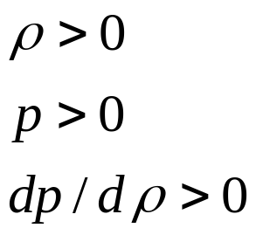

Neutron Stars
Goal: Upperbound on mass based on GR alone
Assumptions:
- Equation of State satisfies
- Equation of State known up to density
Black Holes in General Relativity and Astrophysics

Slide 36
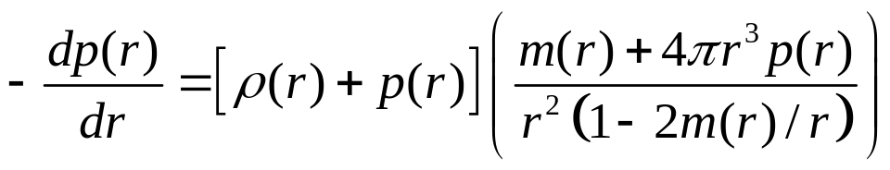


Neutron Stars
Goal: Upperbound on mass based on GR alone
Recall
This implies
We have a core with r < r₀ and ρ > ρ₀ and unknown equation of state
and a mantle with r > r₀ and ρ > ρ₀ where the equation of state is known
For the mass of the core we have
Black Holes in General Relativity and Astrophysics

Slide 37



Neutron Stars
Goal: Upperbound on mass based on GR alone
So we have for the core mass
But core can’t be in its own Schwarzschild radius
So
Any heavier compact object MUST be a Black Hole
Black Holes in General Relativity and Astrophysics

Slide 38
Do Black Holes Exist?
Name | BHC Mass (solar masses) | Companion Mass (solar masses) | Orbital period (days) | Distance from Earth (10³ ly)
A0620-00 | 9−13 | 2.6−2.8 | 0.33 | ~3.5
GRO J1655-40 | 6−6.5 | 2.6−2.8 | 2.8 | 5−10
XTE J1118+480 | 6.4−7.2 | 6−6.5 | 0.17 | 6.2
Cyg X-1 | 7−13 | ≥18 | 5.6 | 6−8
GRO J0422+32 | 3−5 | 1.1 | 0.21 | ~ 8.5
GS 2000+25 | 7−8 | 4.9−5.1 | 0.35 | ~ 8.8
V404 Cyg | 10−14 | 6.0 | 6.5 | ~ 10
GX 339-4 |  | 5−6 | 1.75 | ~ 15
GRS 1124-683 | 6.5−8.2 |  | 0.43 | ~ 17
XTE J1550-564 | 10−11 | 6.0−7.5 | 1.5 | ~ 17
XTE J1819-254 | 10−18 | ~3 | 2.8 | < 25
4U 1543-475 | 8−10 | 0.25 | 1.1 | ~ 24
GRS 1915+105 | >14 | ~1 | 33.5 | ~ 40
Black Holes in General Relativity and Astrophysics

Slide 39

Do Black Holes Exist?
Black Holes in General Relativity and Astrophysics

